Slide 1
Silicon Photonics Process Maturing

Slide 2
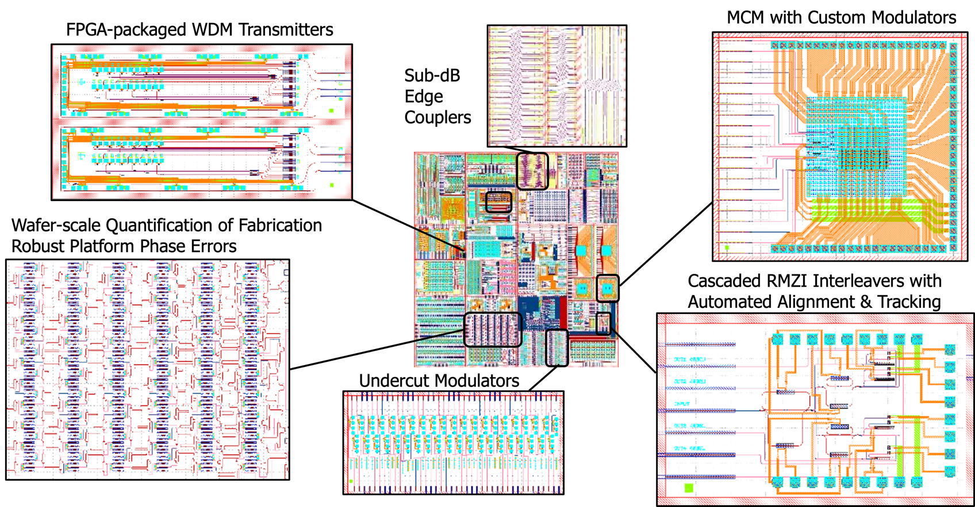
Cedar 300 mm Wafer Tapeout (Nov. 2011)

Slide 3
Oak 300 mm Wafer Tapeout (Sep. 2022)

Slide 4
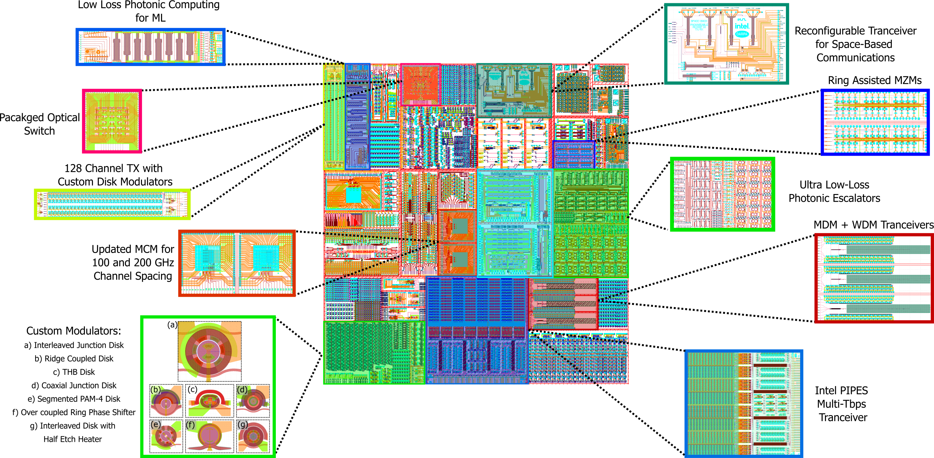
Willow 300 mm Wafer Tapeout (Nov. 2023)

Slide 5
Custom Microdisk Modulators

Slide 6
Interleaver Tuning Challenge
Same photocurrent for multiple cases
Need additional monitoring structure

Slide 7
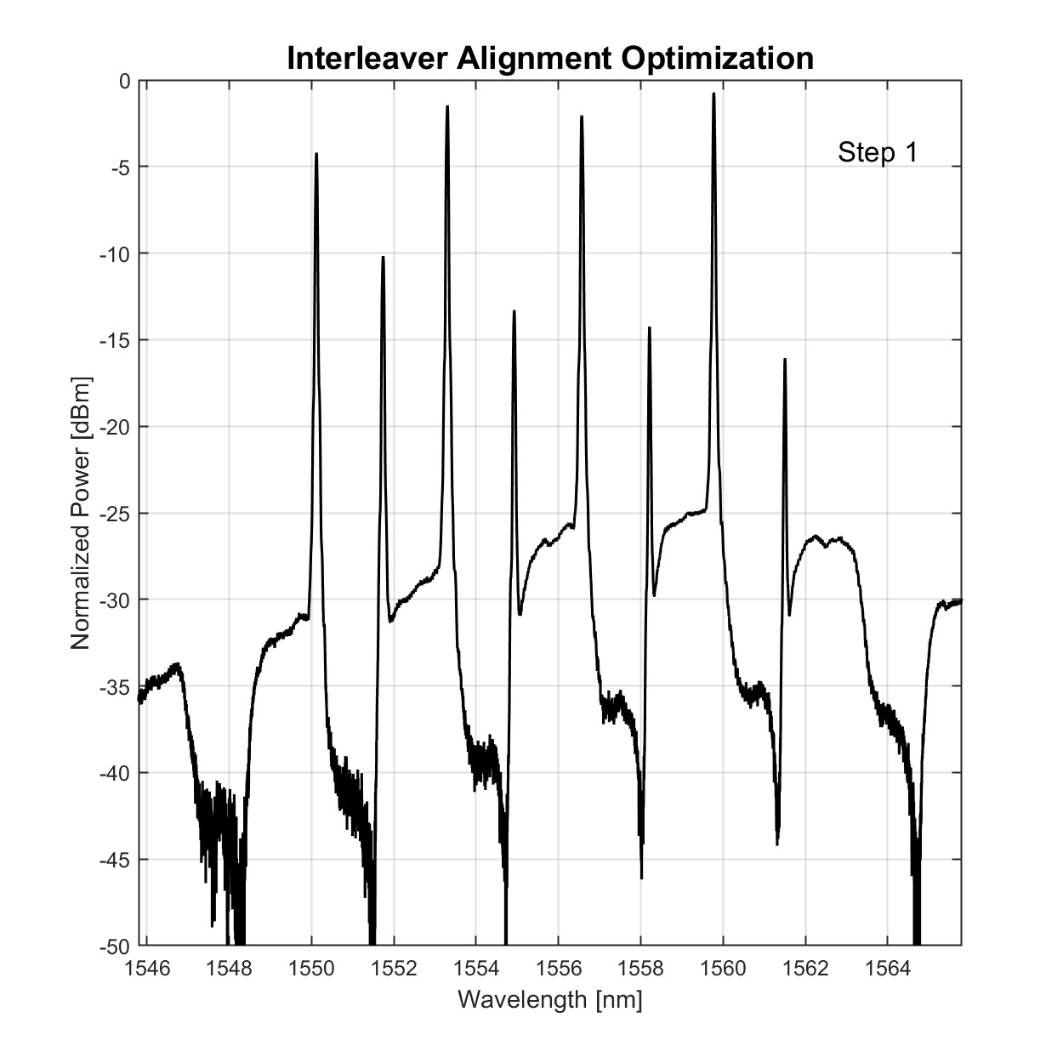




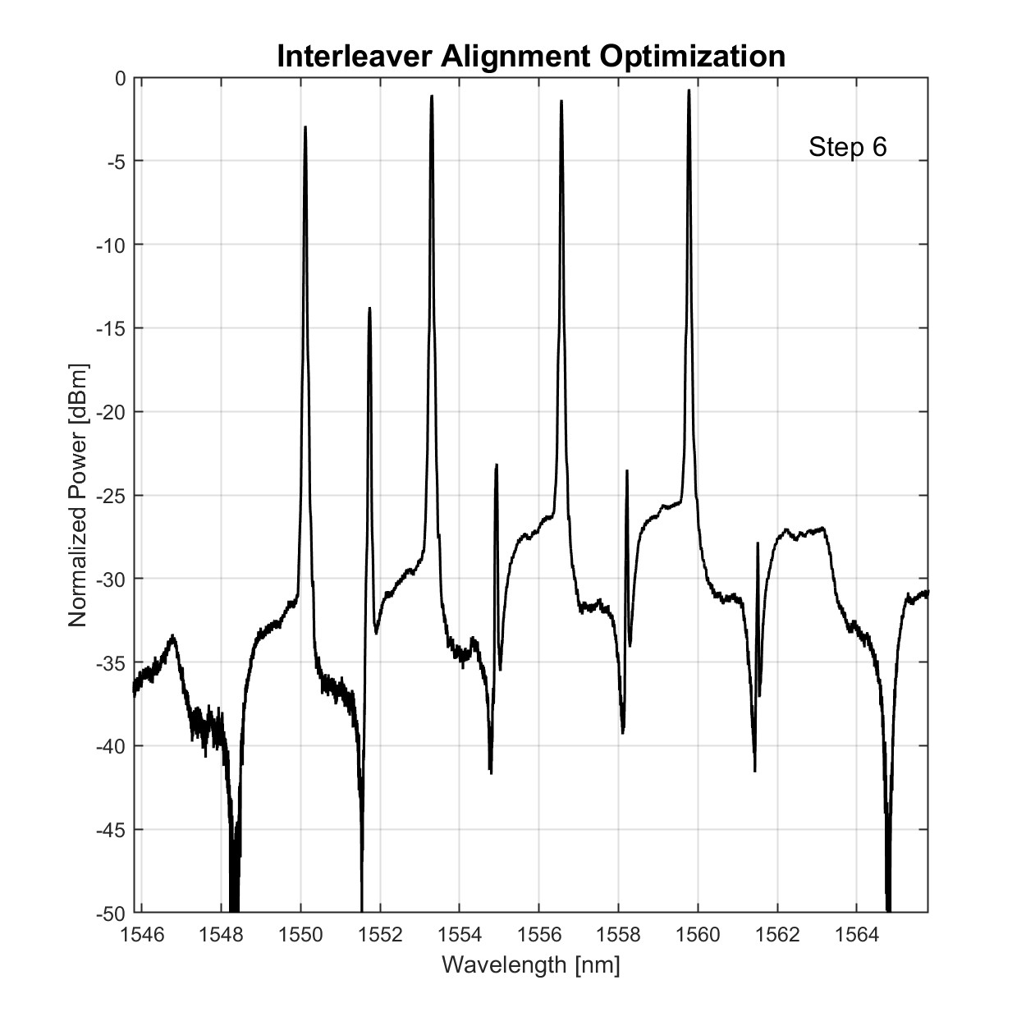
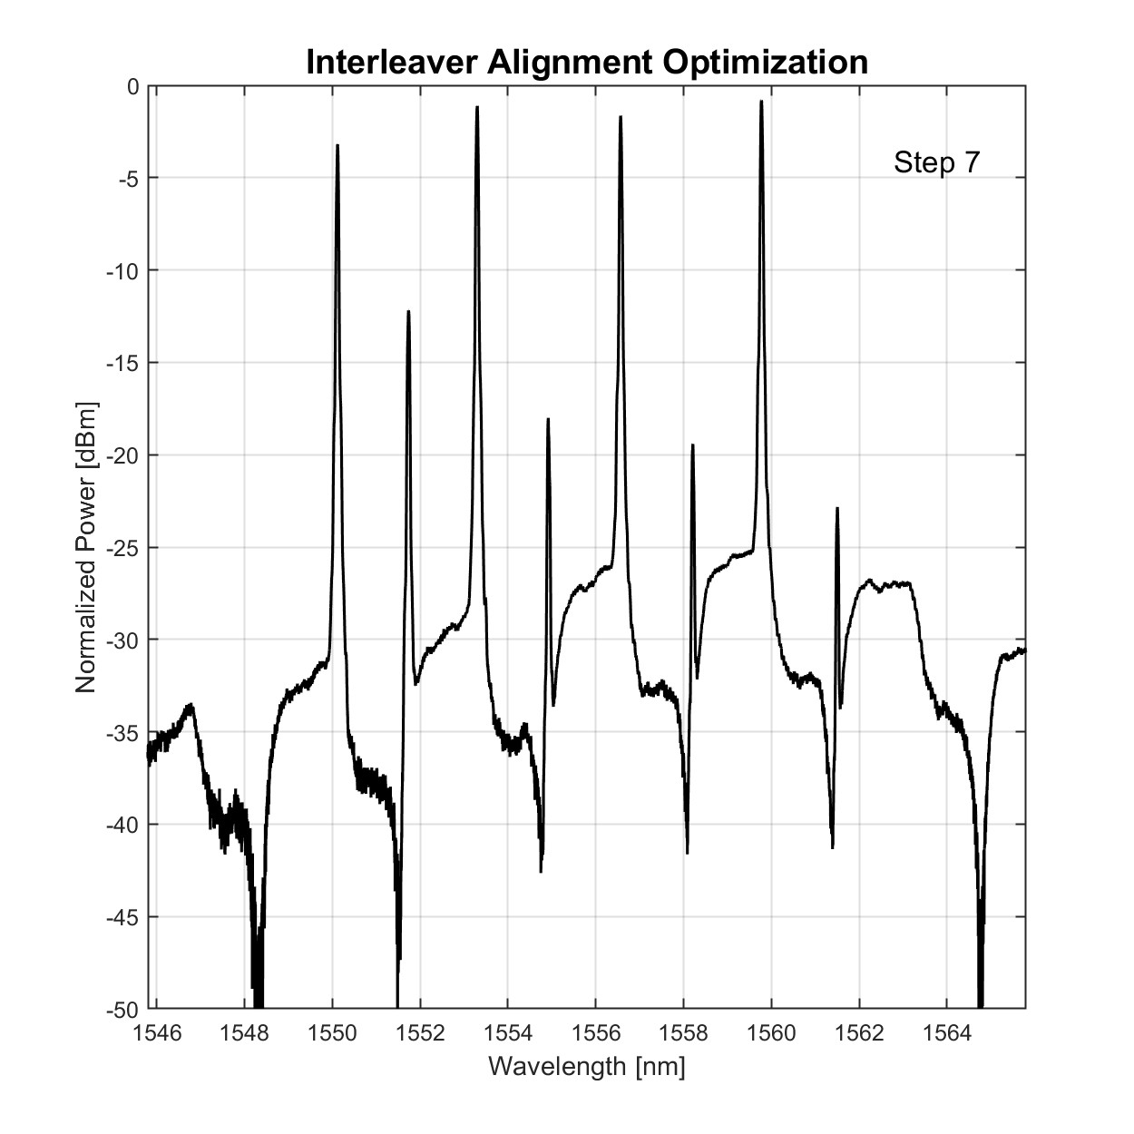
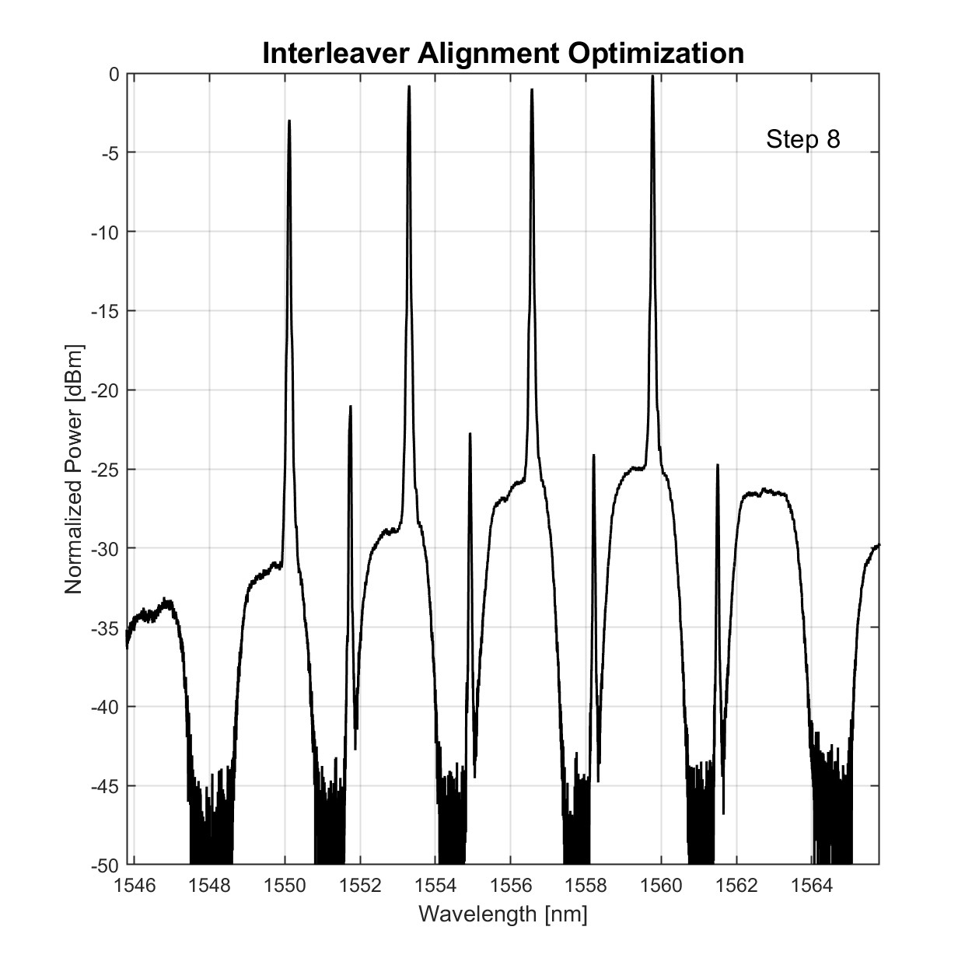
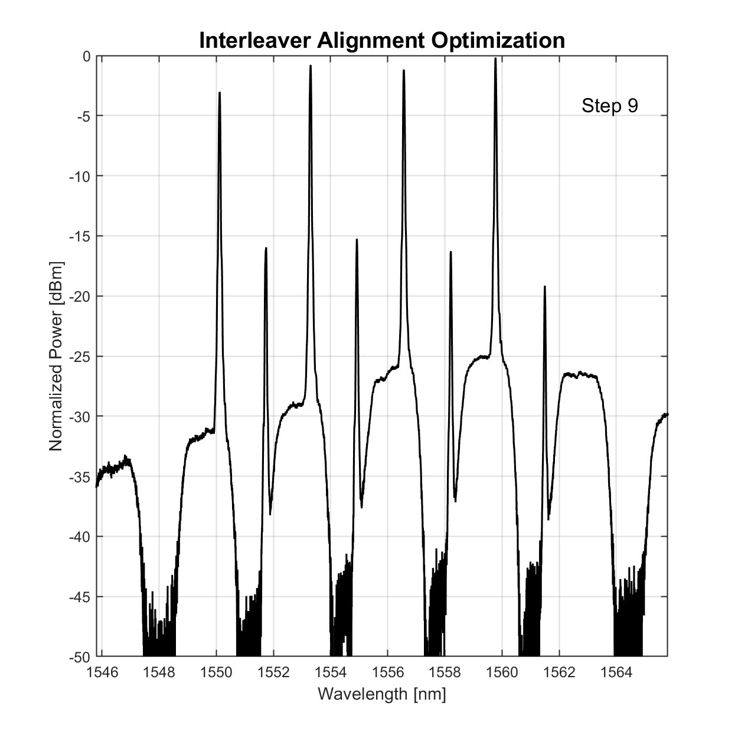
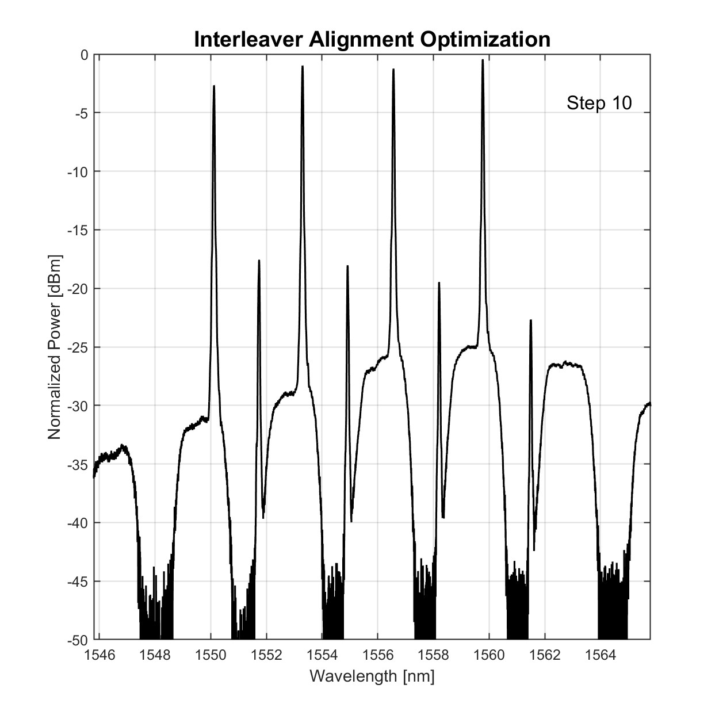
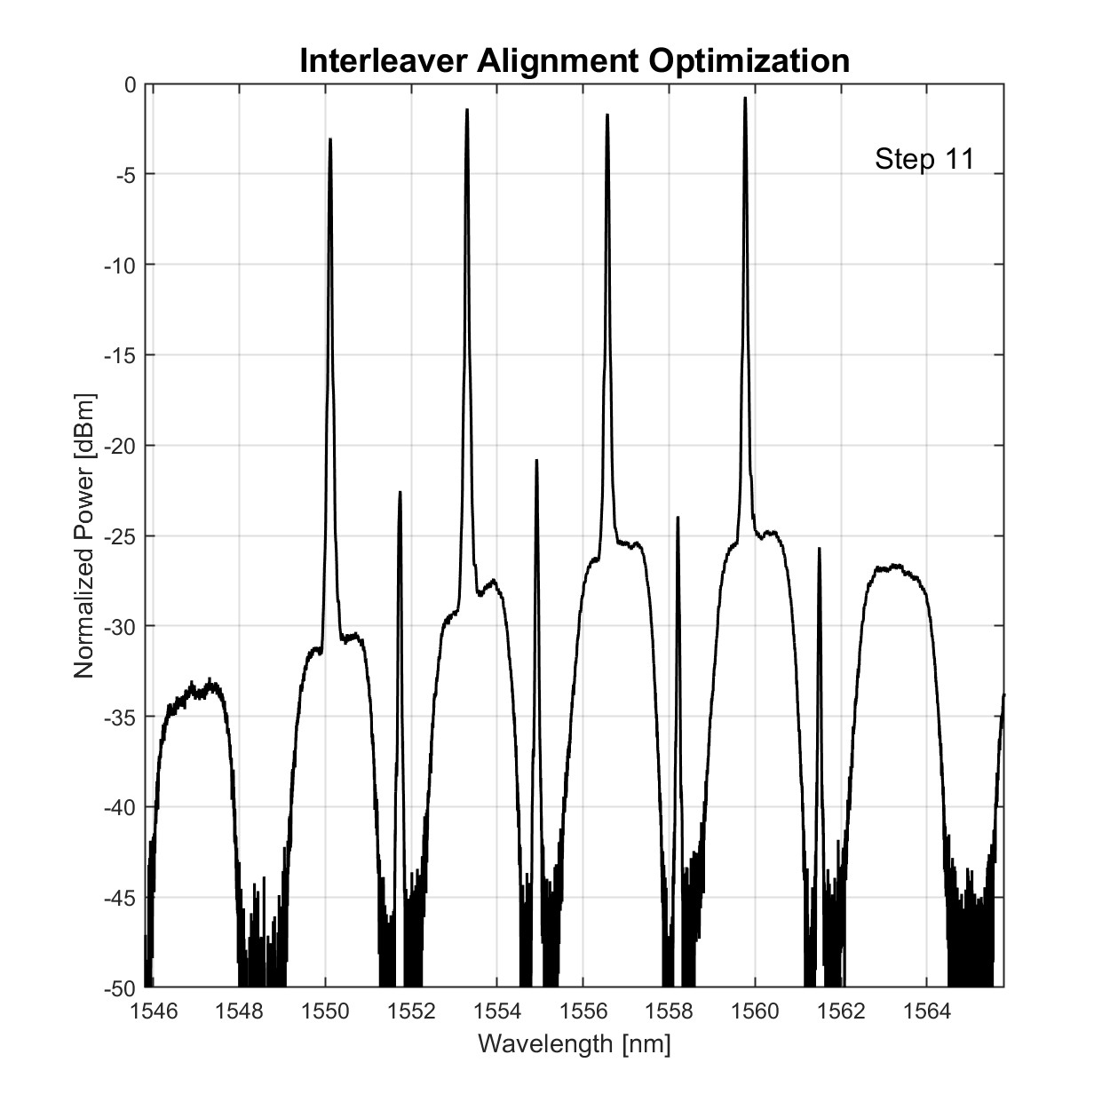
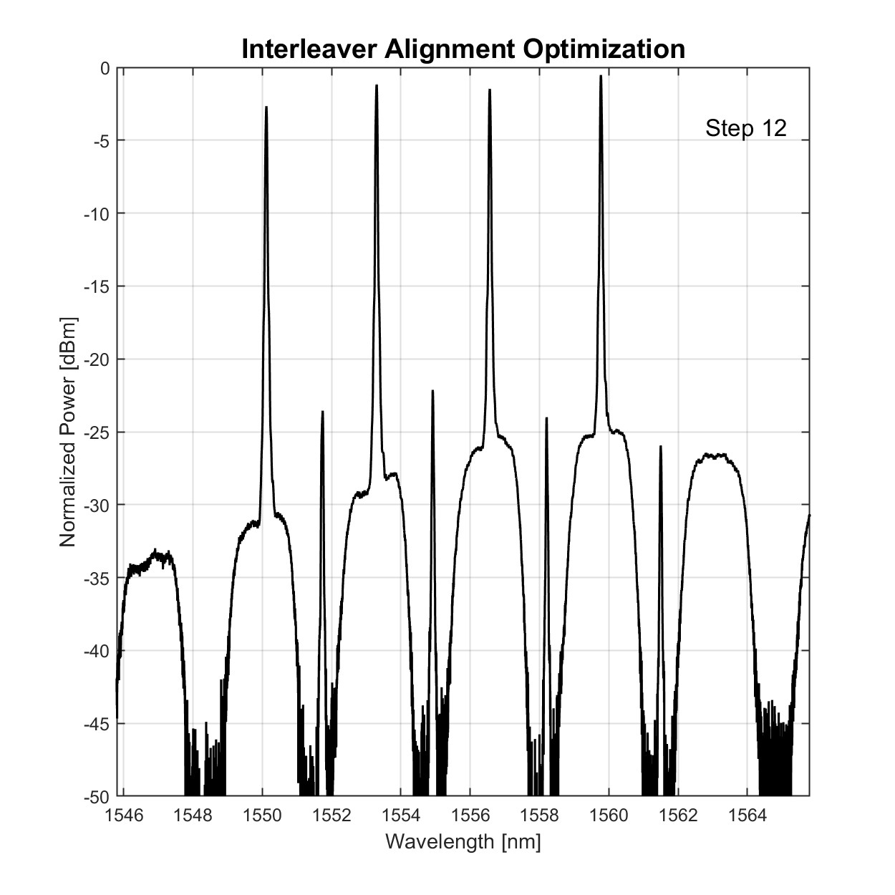
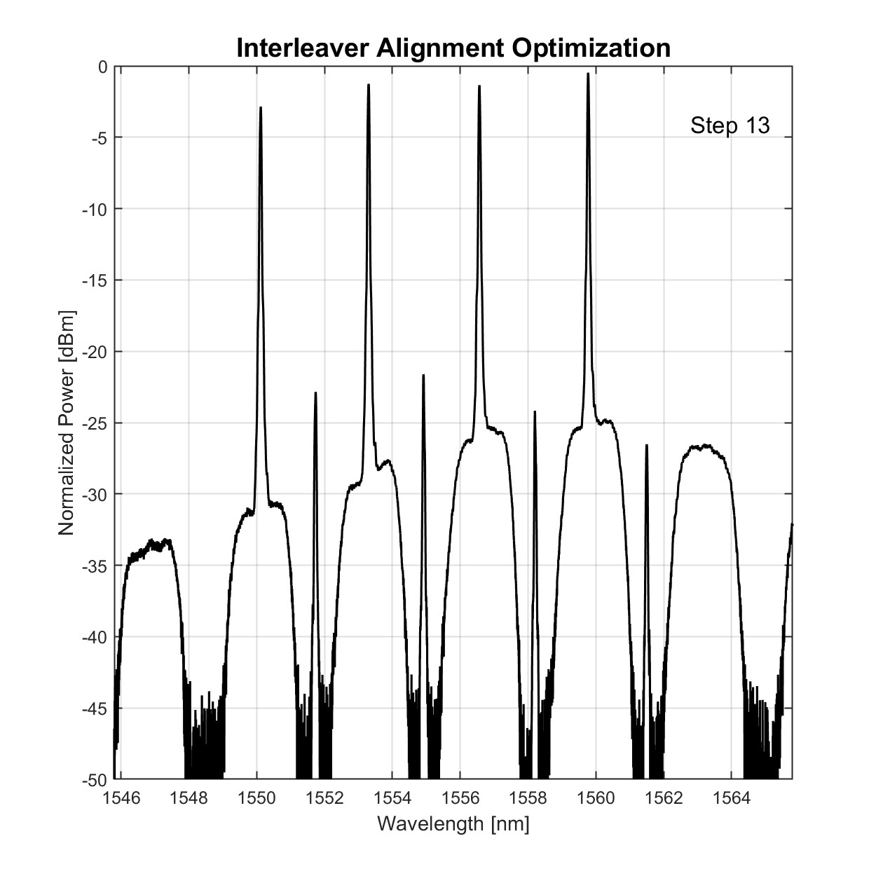
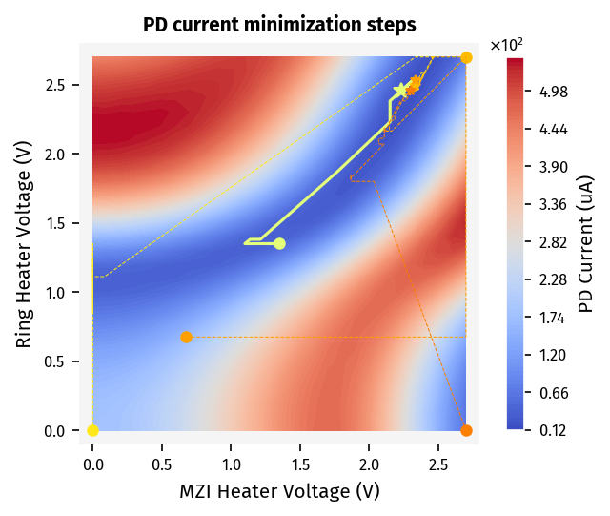

Interleaver Tuning Demonstration
Step-by-step PD current evolution
PD current heatmap w/ monitor MZI voltage found to be 0.8V
Dot: initial voltage Star: final voltage
Each line is an optimization run with a different starting point for demonstrating tuning robustness
Spectral evolution corresponding to the highlighted yellow path

Slide 8
Thermal Undercut

Slide 9
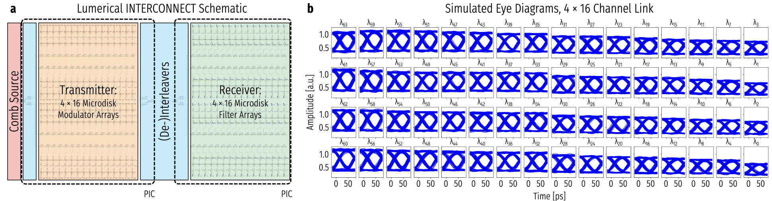
Full Link Simulation

Slide 10
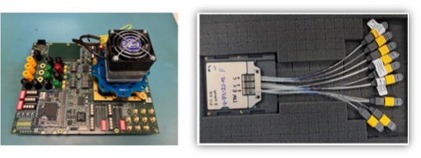
MCP and Platform

Slide 11
Photonic-Enabled Resource Disaggregation

Slide 12
Replacing Local HBMs with Optical I/O

Slide 13
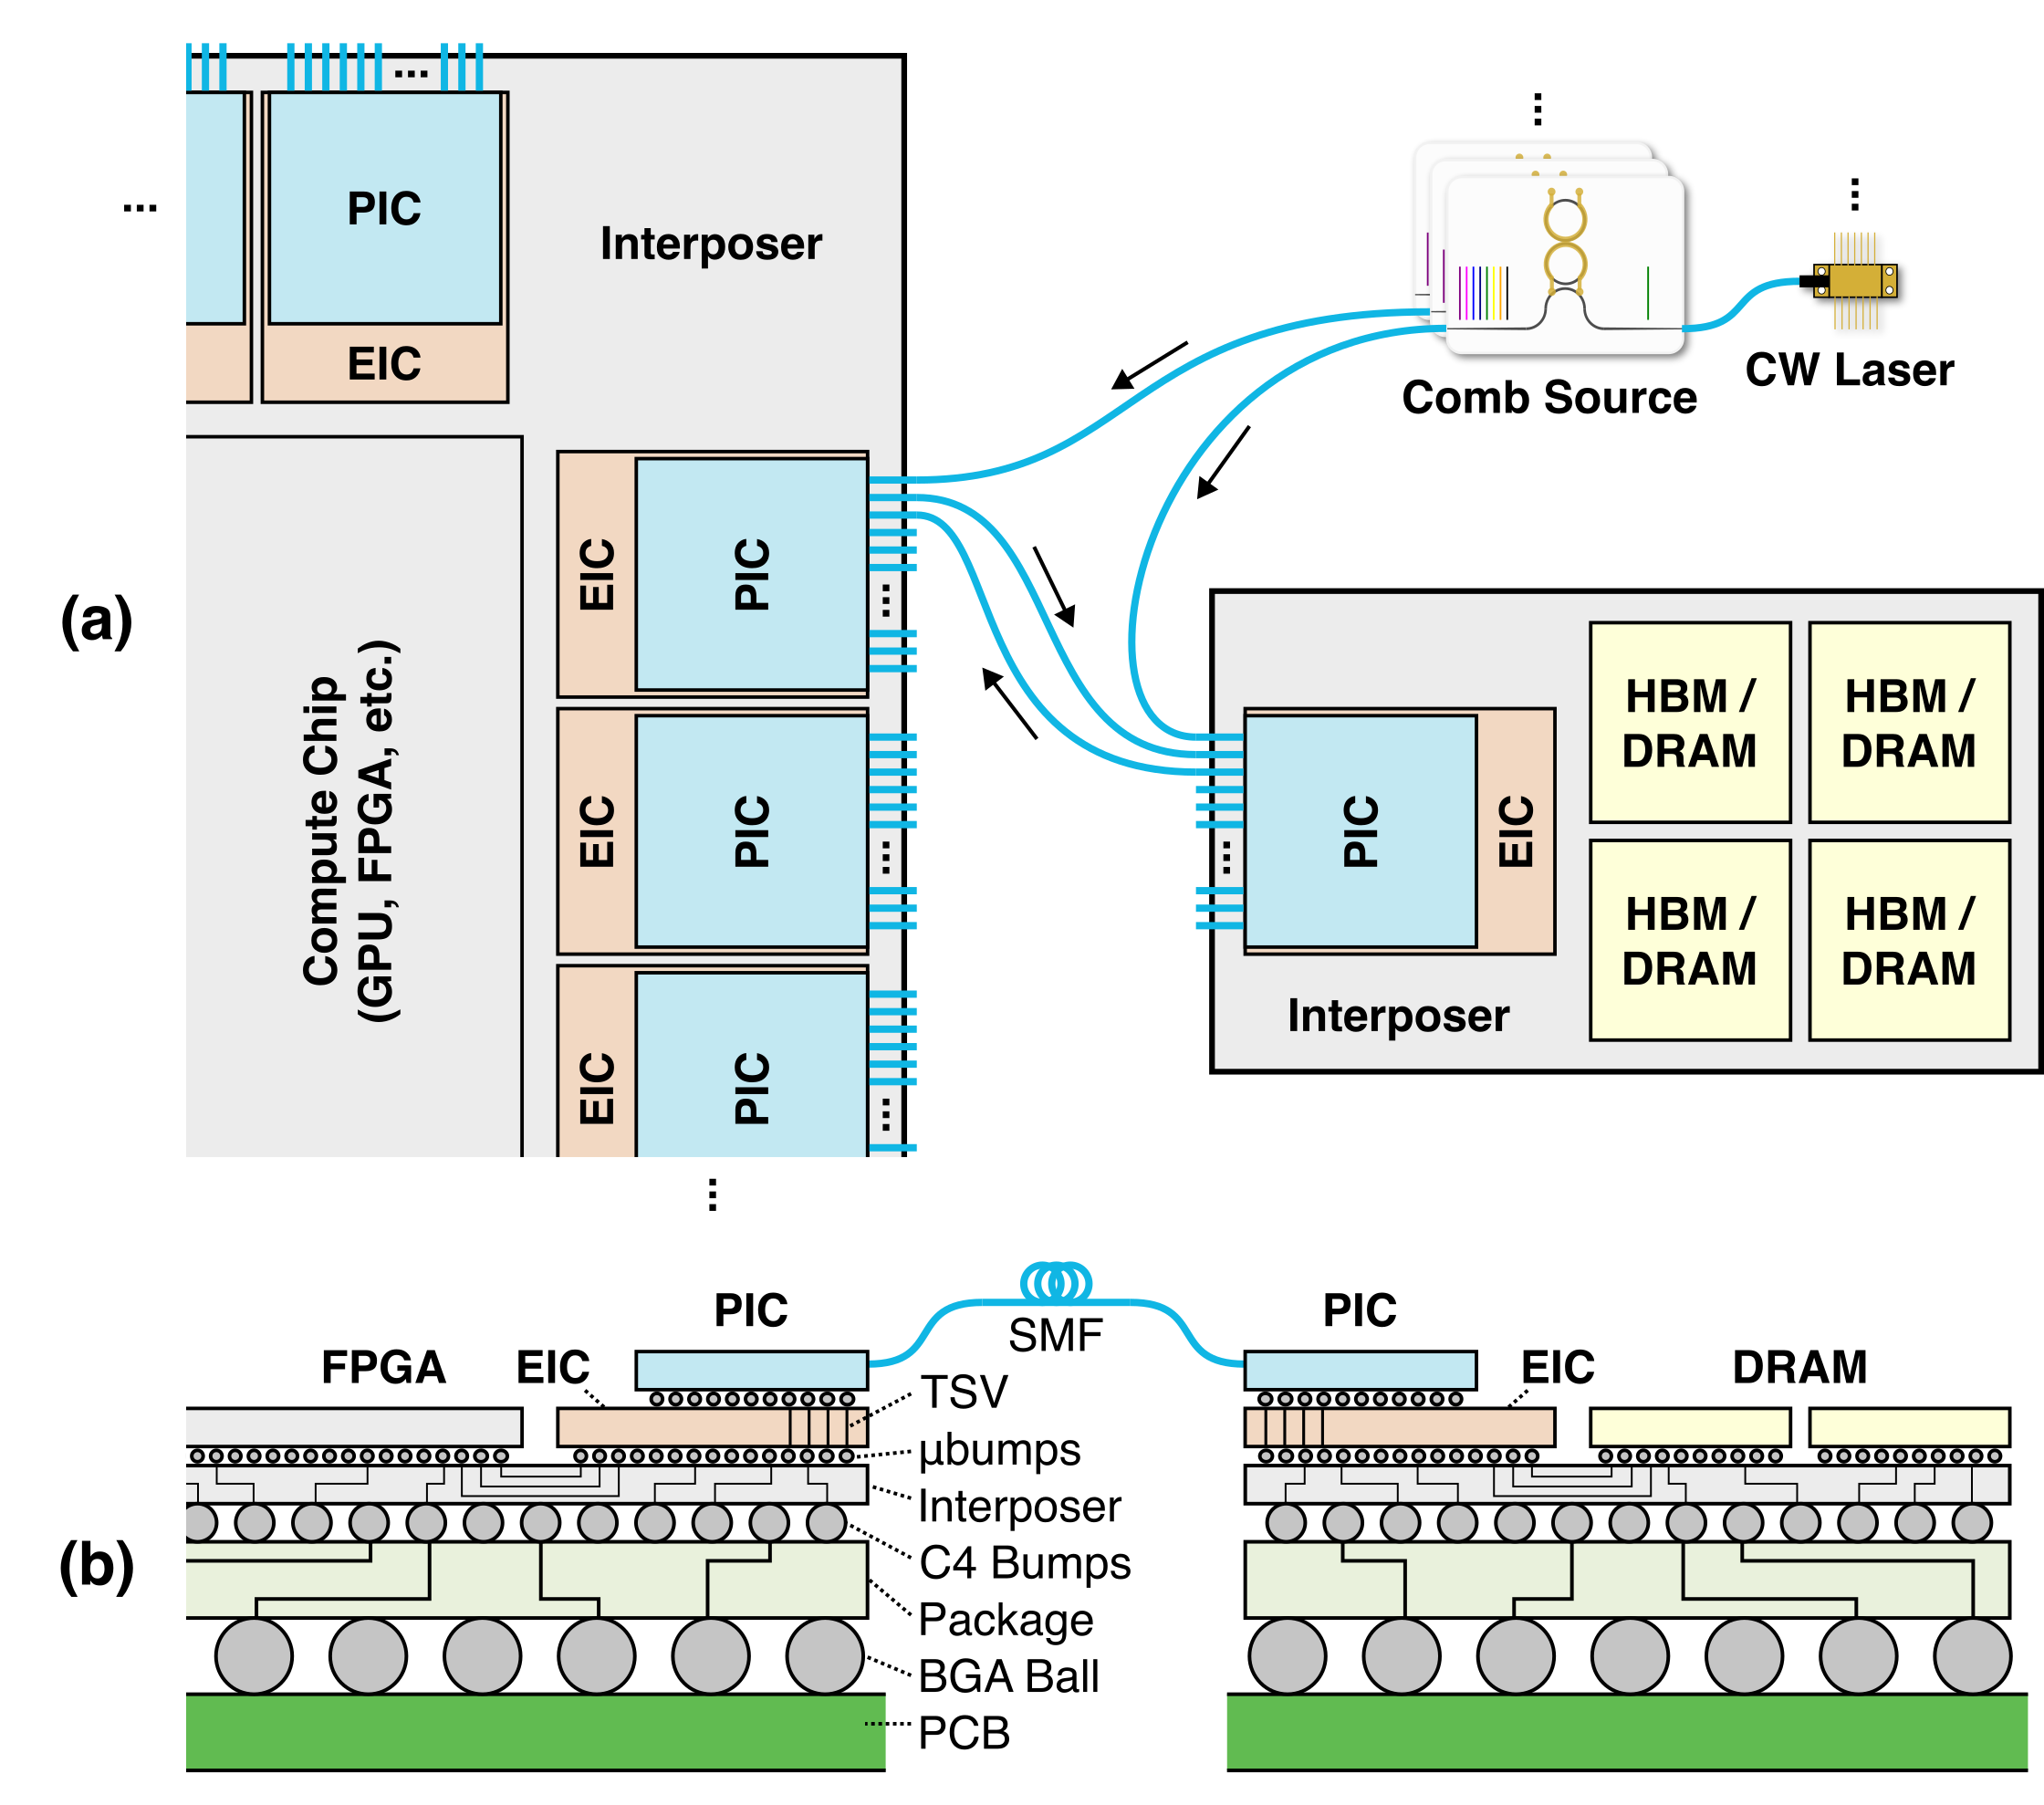

Slide 14
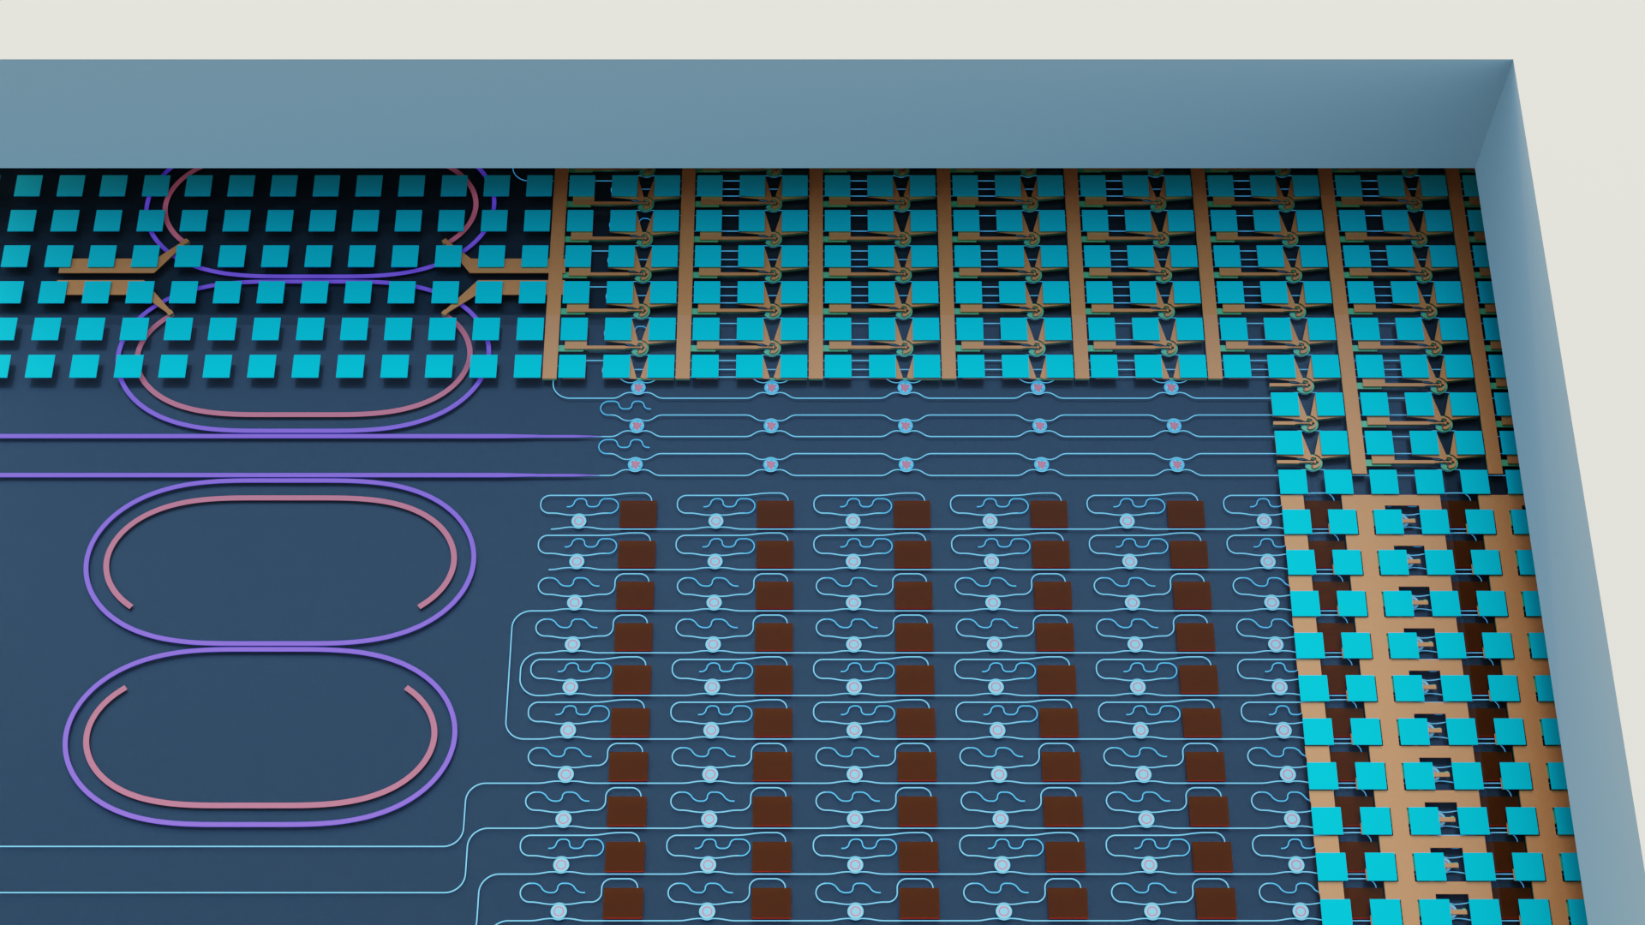
On-Chip Comb Integration
Driver EIC
Metal RDL
Doped Silicon Heater
Si₃N₄ Comb Generator
Si Microresonators
Photodetectors

Slide 15
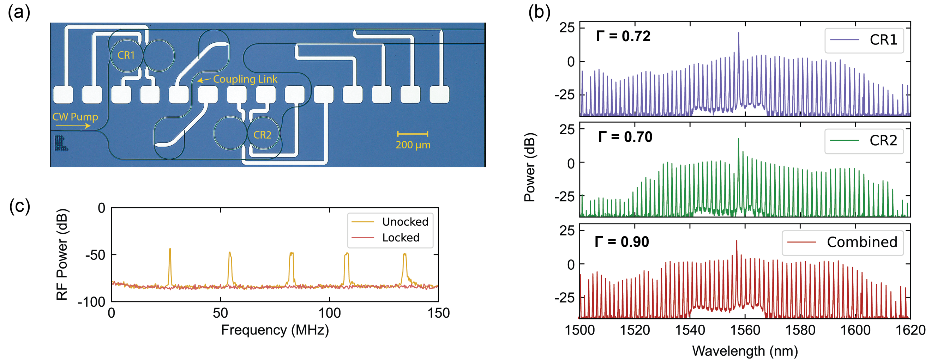
Spectral-Flat Comb

Slide 16
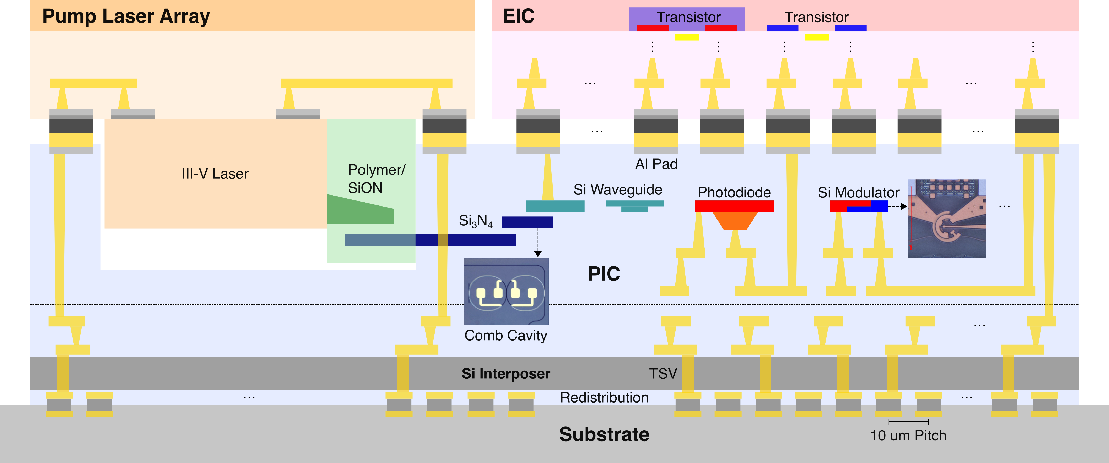
Active Photonic Interposer and Laser Co-Packaging

Slide 17
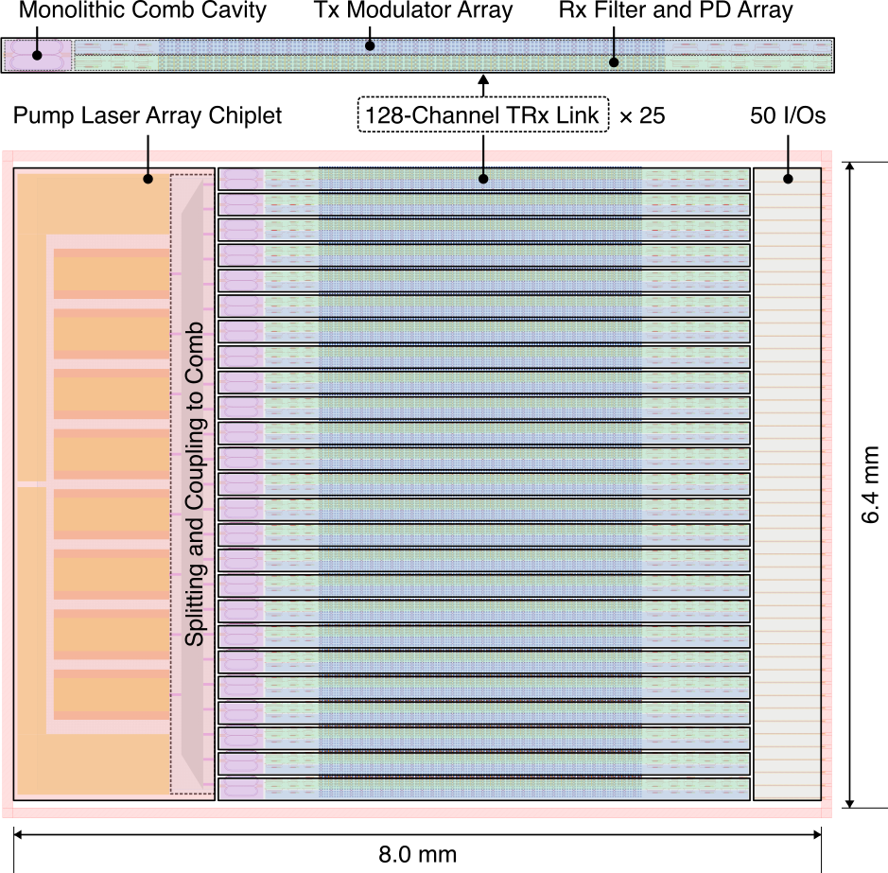
Pathway to 32 Tb/s/mm

Slide 18
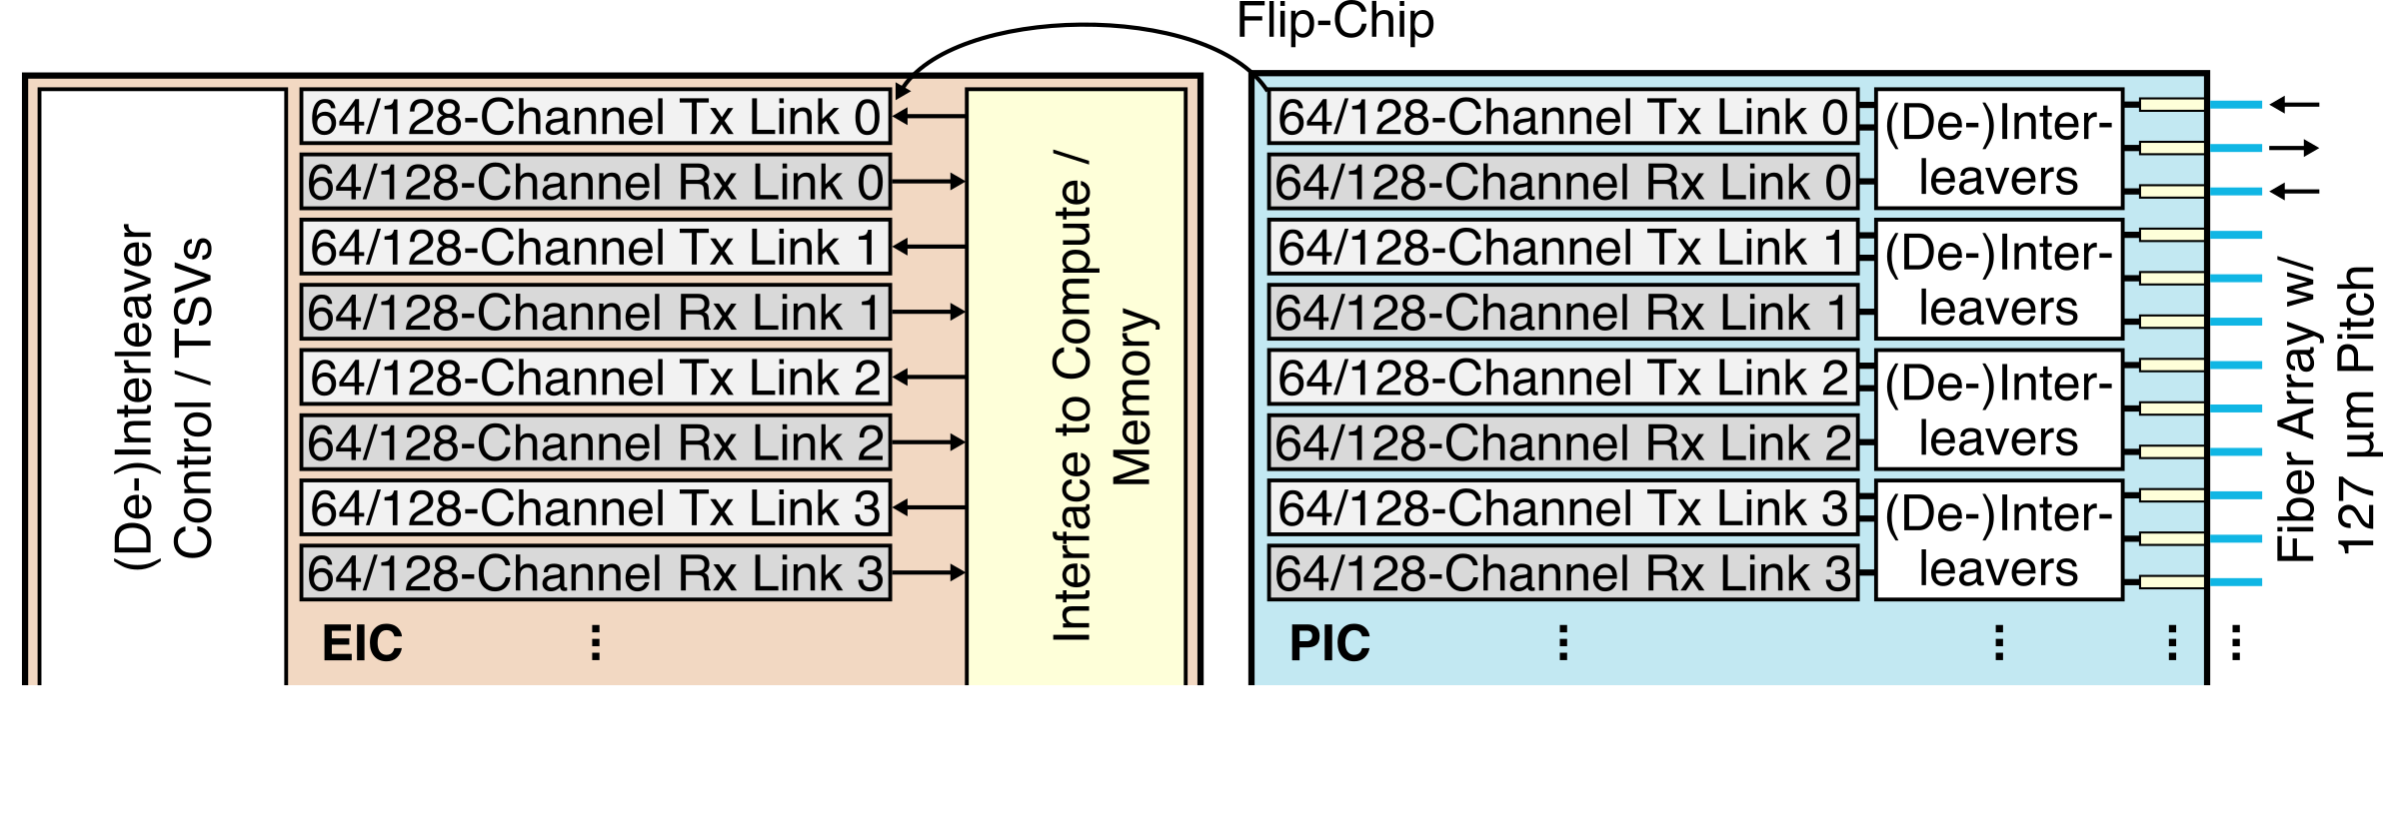

Slide 19
Energy Breakdown

Slide 20
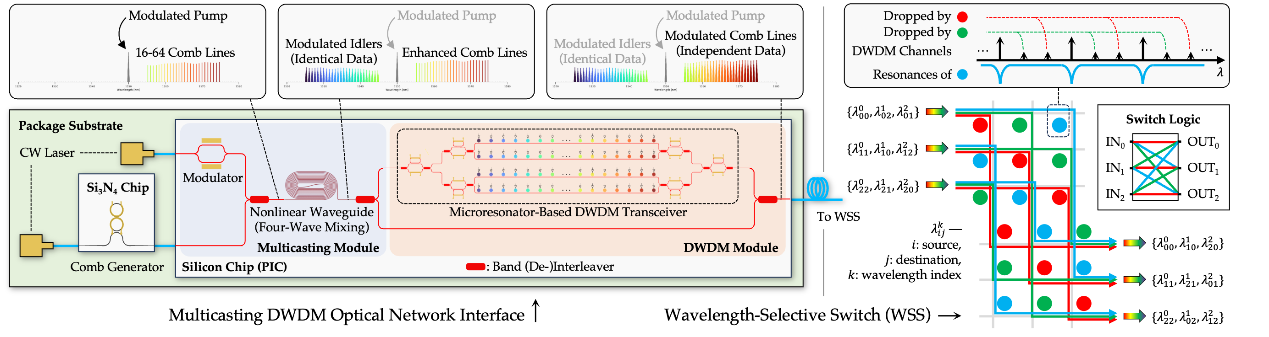
Optical Broadcasting and Switching

Slide 21
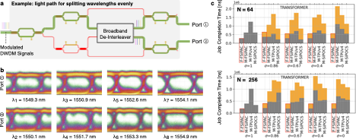
Reconfigurable Multi-Port Transceiver

Slide 22
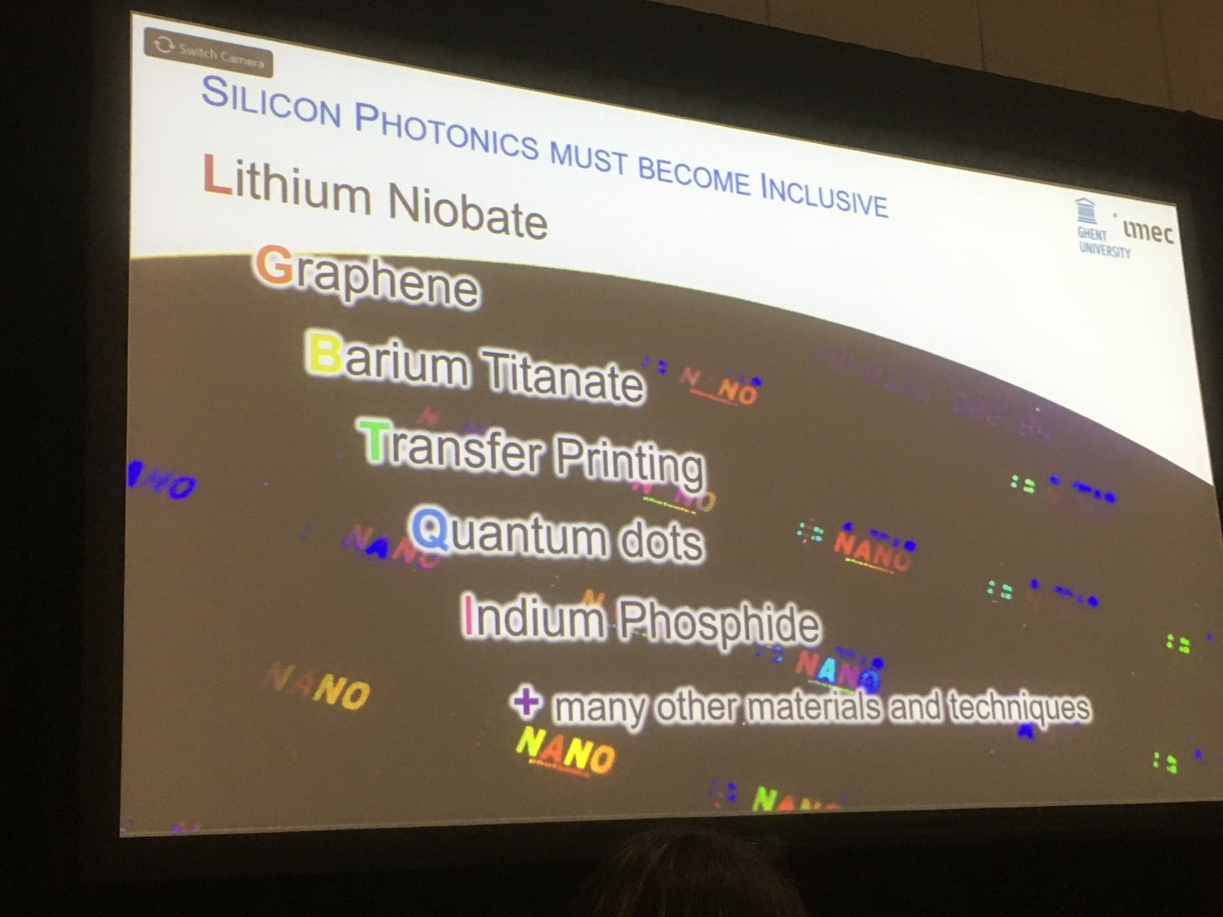
Credit: Wim Bogaerts

